Slide 1
Data Science
By Ahmed Mohsen Ahmed
ID:202200061

Slide 2
Project goal
Domain of project: Social Media Sentiment Analysis.
Media analysis is to gather comments of certain thing/topic and evaluate the emotions behind certain comments (if they are positive, negative, or neutral).
For this project we acquired our data from Kaggle and more data was scraped from Reddit r/2024Election.

Slide 3
Project Work
For this project our Aim is to solve three research questions
1- Can we create an NLP model for predicting Sentiment values of comments?
2- Is there any correlation with comment length and Sentiment values?
3- Are there certain words that are common in positive or negative comments?
We give detailed explanation of each question as we have text outputs and graphs

Slide 4
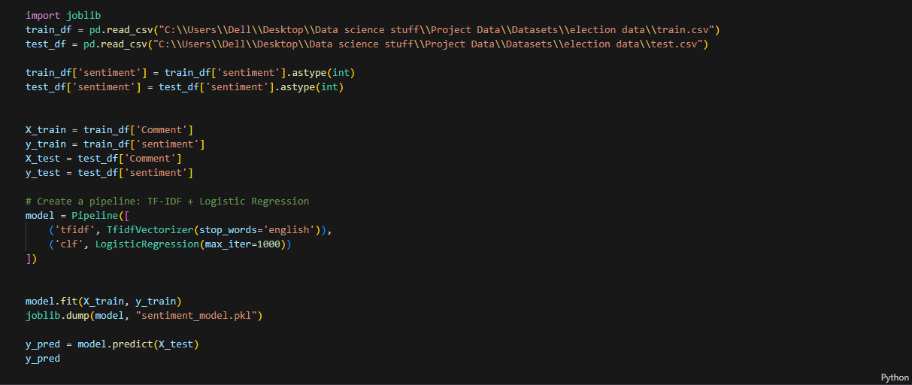
Machine learning Model
This Model being trained and test for its predictions.
We have pipeline here to use two different types of models logistic Regression and Term frequency-inverse Document Frequency.

Slide 5
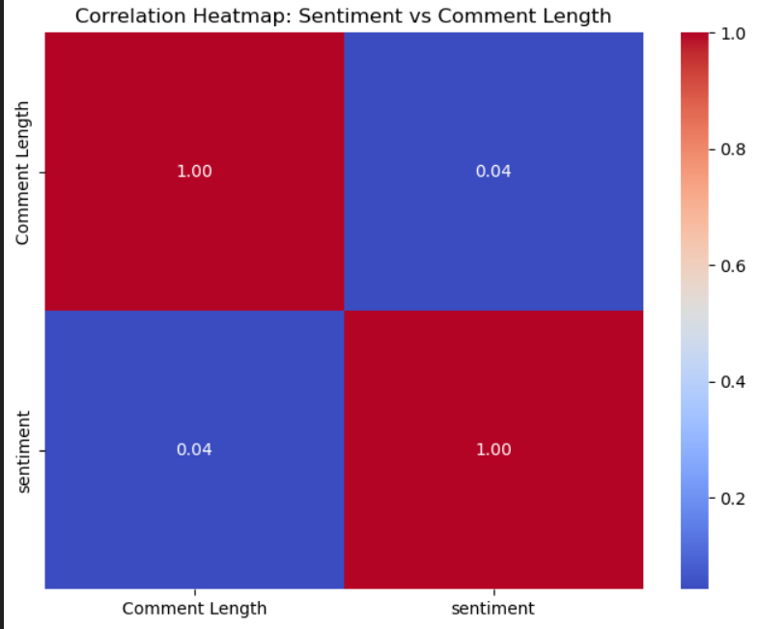
Comment length vs Sentiment value
This heatmap that tells us that there is the correlation
Is 0.4 which means there almost no correlation meaning long or short comments have no effect on sentimental value.

Slide 6
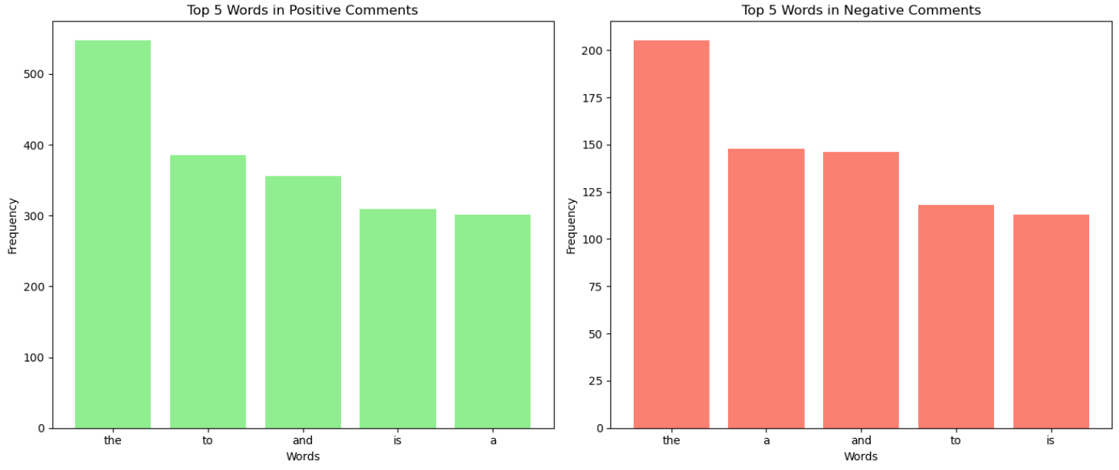
Most repeated words(Negative vs Positive)
Shows frequency of tops 5 words for positive and negative comments (unweighted)

Slide 7
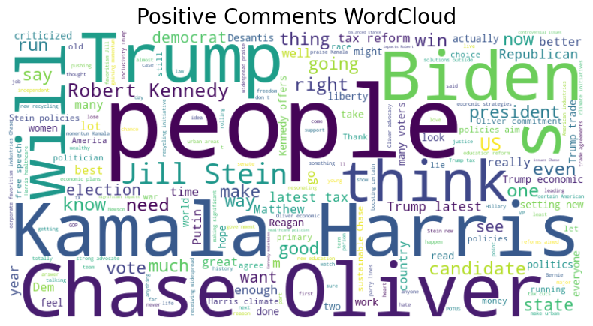
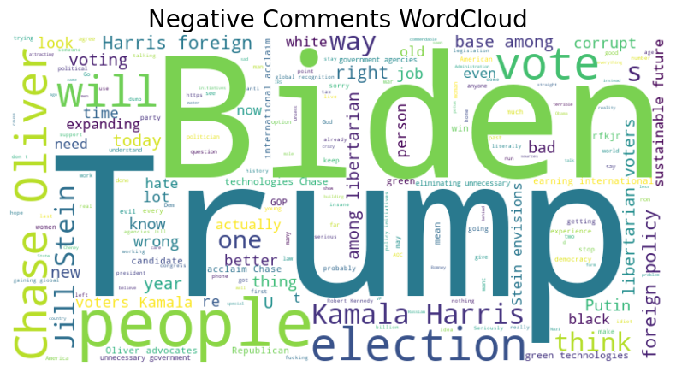
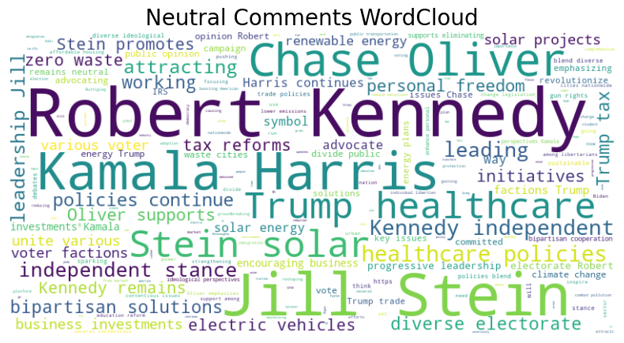
Most repeated words (Weighted)

Slide 8
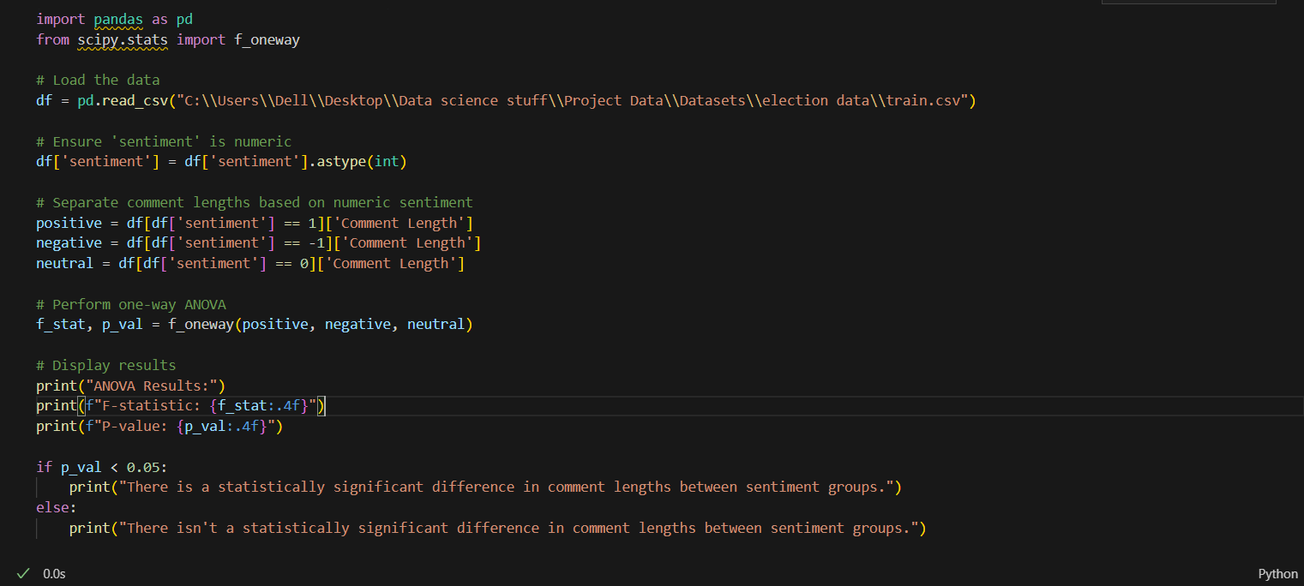
Most interesting part of the code

Slide 9
Biggest Challenges Faced
Finding the feature engineering required for the solving research.
Management of the data to make sure no errors in the input can mess with my model.
Finding the best model to use for our ML Model

Slide 10


